Slide 1
DSI - Misk
Generalized Linear Models
Ammar Yasser AlHawashem

Slide 2
Introduction
Generalized Linead Model
OLS Linear Regression Model

Slide 3
Table of contents
Review OLS LM
01
GLM’s
02
Link function Vs Transformation
03
GLM’s in R
04
Q & A
05
As it is necesessary to be able to understand GLM’s
The main topic
A commonly misundesrtood point
Put it in practice
To clarify any misundersranding

Slide 4
01
Review OLS LM

Slide 5


Recap naming
Dependable Variable
Indepdent Variable/s
Response
Outcome
Observation
Target
Predictor
Regressor
Explanatory Variable
Feature

Slide 6


Are these can represent a linear model
$$y= β_{1}x + β_{0}+ ε$$
${\hat{y}}_{i}= \hat{β_{1}}x_{i}+ \hat{β_{0}}$
${\hat{y}}_{i}=\hat{β_{1}}x_{i}^{2}+ \hat{β_{0}}$
$\hat{log⁡(y_{i})}=\hat{β_{1}}x_{i}+ \hat{β_{0}}$
${\hat{y}}_{i}= \hat{e^{β_{1}}}x_{i}+ \hat{β_{0}}$

Slide 7

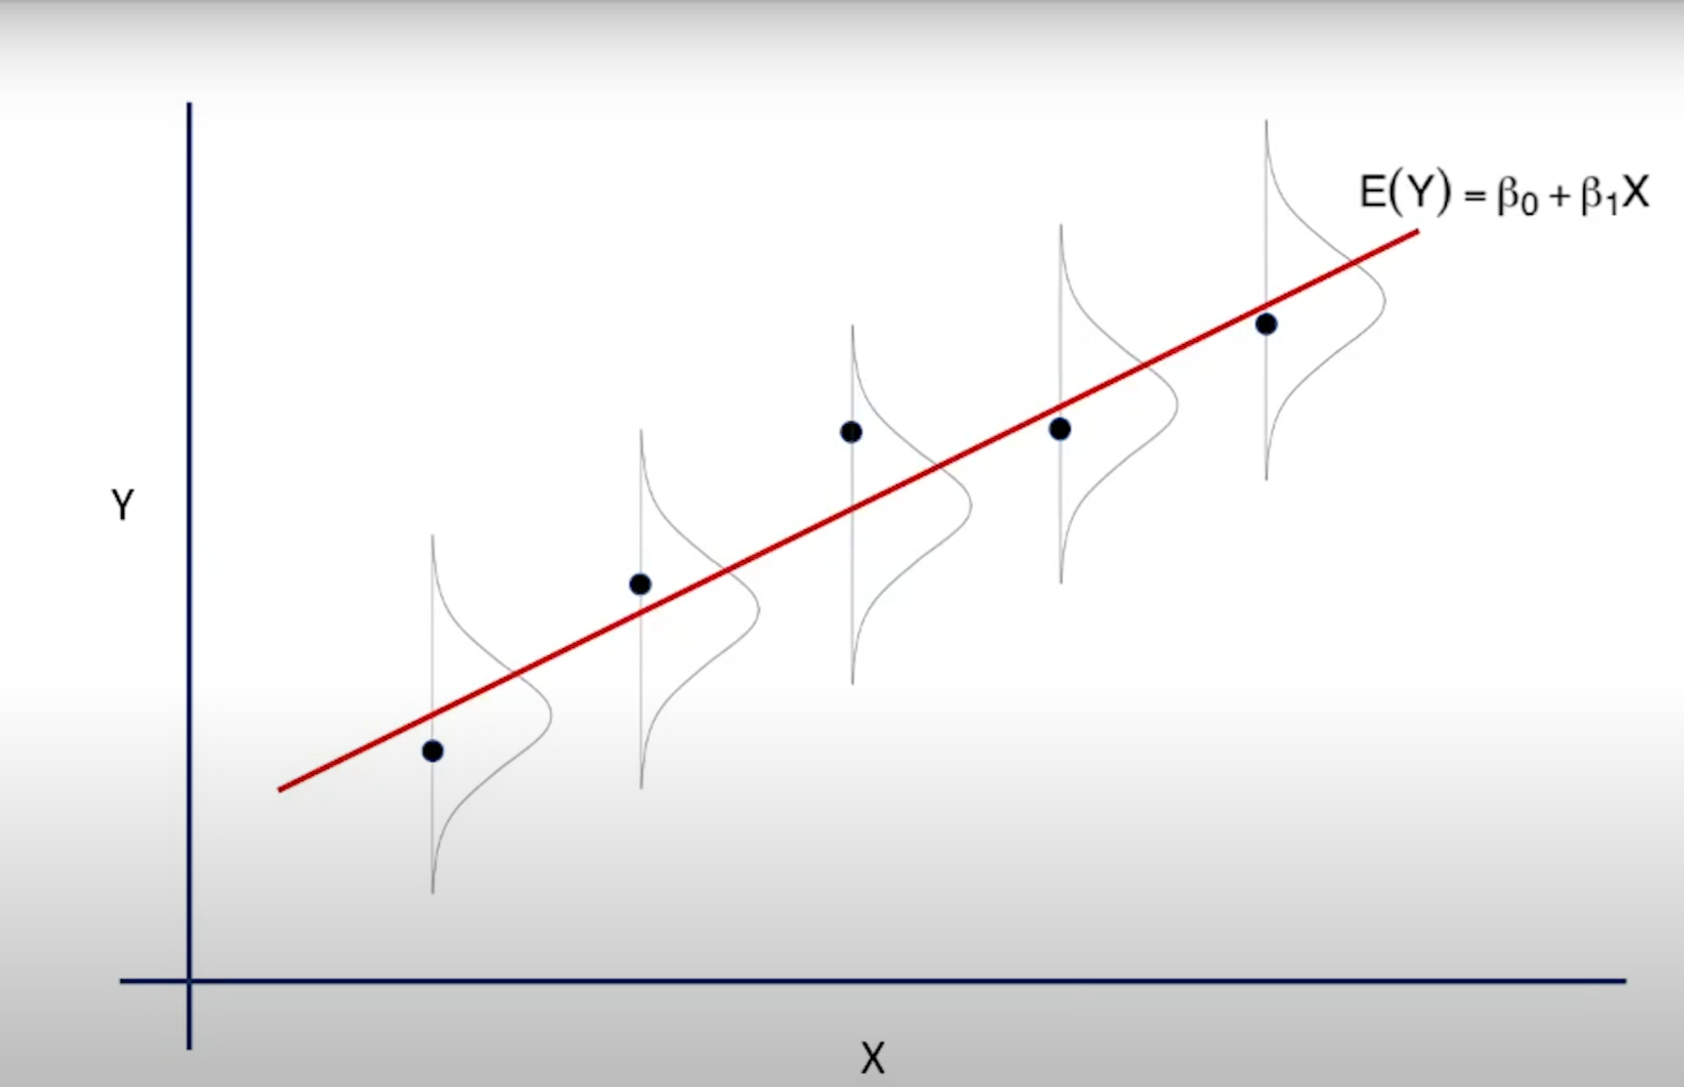
OLS Assumptions
Source: video from the Pennsylvania State university

Slide 8
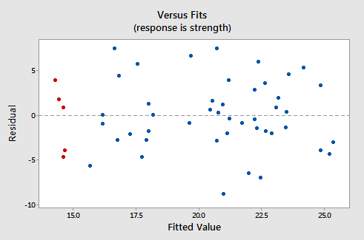
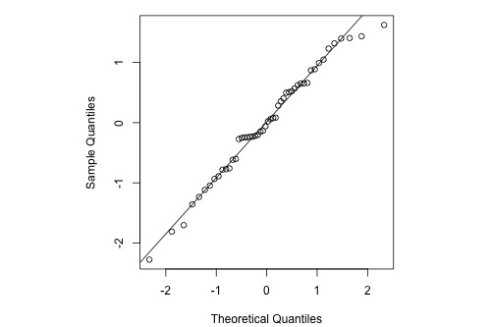
How to check these Assumptions:
Lesson 4: SLR Model Assumptions | STAT 501 (psu.edu)
Residual Vs Fitted (predicted) values
Normal Probability Plot of residuals
R TIP: plot(lm(data = <data frame> , formula = <y> ~ <x> ))
R TIP: plot(lm(data = <data frame> , formula = <y> ~ <x> ))

Slide 9
02
GLM’s

Slide 10
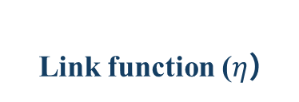
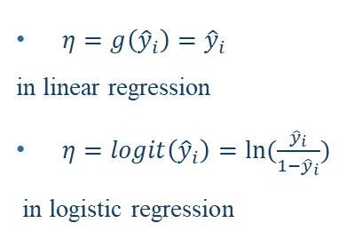
GLM’s Components
Random Component
Systematic Component
Link function ($η$)
Linear Regression
(normal distribution)
Binary logistic regression
(binomial distribution)
i.e.
B₀ + B₁X₁
How the regression parameters can be calculated?
$η=g\left({\hat{y}}_{i}\right)={\hat{y}}_{i}$
in linear regression
$η=logit\left({\hat{y}}_{i}\right)=ln⁡(\frac{{\hat{y}}_{i}}{1−{\hat{y}}_{i}})$
in logistic regression

Slide 11
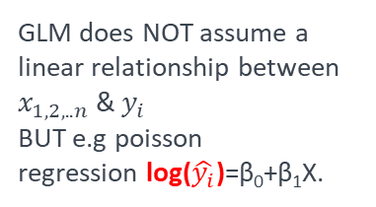
GLM’s Assumptions
Independent
Normally Distributed
Equal Variances
Linear Function
The observations still need to be independent
but NOT necessary normally distributed
The homogeneity of variance does NOT need to be satisfied
GLM does NOT assume a linear relationship between
$x_{1,2,..n}$ & $y_{i}$
BUT e.g poisson regression log($\hat{y_{i}}$)=β₀+β₁X.

Slide 12
Summary (Just Examples)
Model | Random Component (Probability Distribution) | Link Function | Systematic Component
Linear Regression | Normal | Identity | Continuous
ANOVA | Normal | Identity | Categorical
ANCOVA | Normal | Identity | Mixed (Continuous, Categorical)
Logistic Regression | Binomial | Logit | Mixed (Continuous, Categorical)
Loglinear | Poisson | Log | Categorical
Multinomial Response | Multinomial | Generalized Logit | Mixed (Continuous, Categorical)

Slide 13
03
Link function Vs Transformation

Slide 14
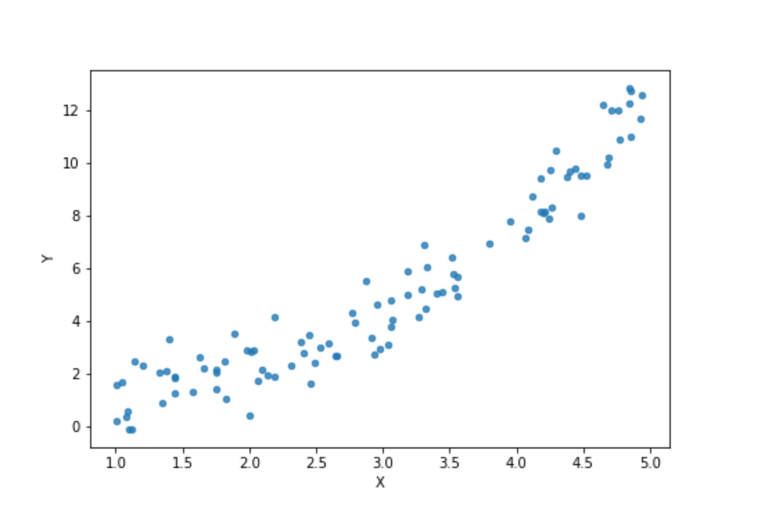

Slide 15
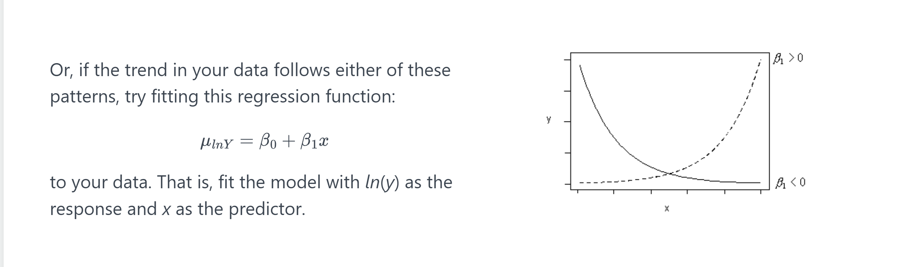
Y Vs X
Source: Stat501 Lesson9.4 from the Pennsylvania State university

Slide 16
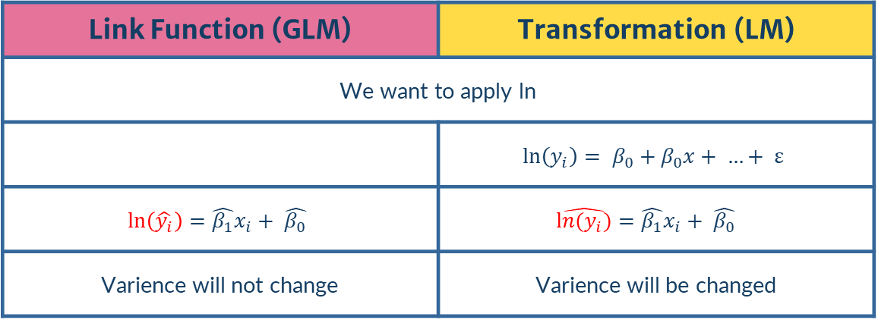
Link function Vs Transformation
Model | Random Component (Error Distribution) | Link Function | Systematic Component
Linear Regression | Normal | Identity | Continuous
ANOVA | Normal | Identity | Categorical
ANCOVA | Normal | Identity | Mixed (Continuous, Categorical, or both)
Logistic Regression | Binomial | Logit | Mixed (Continuous, Categorical, or both)
Loglinear | Poisson | Log | Categorical
Multinomial Response | Multinomial | Generalized Logit | Mixed (Continuous, Categorical, or both)
Link Function (GLM) | Transformation (LM)
We want to apply ln
 | $$\ln\left(y_{i}\right)= β_{0}+β_{0}x+ …+ ε$$
$$\ln\left(\hat{y_{i}}\right)=\hat{β_{1}}x_{i}+ \hat{β_{0}}$$ | $$\hat{ln(y_{i})}=\hat{β_{1}}x_{i}+ \hat{β_{0}}$$
Varience will not change | Varience will be changed
family(distribution) = poisson

Slide 17
GLM
Nonlinear and/or non equal variance
Just nonlinear
LM
Transform Y
Transform x
variances are unequal and/or error terms are not normal
Box-Cox Y Transformation

Slide 18
04
GLM’s in R

Slide 19
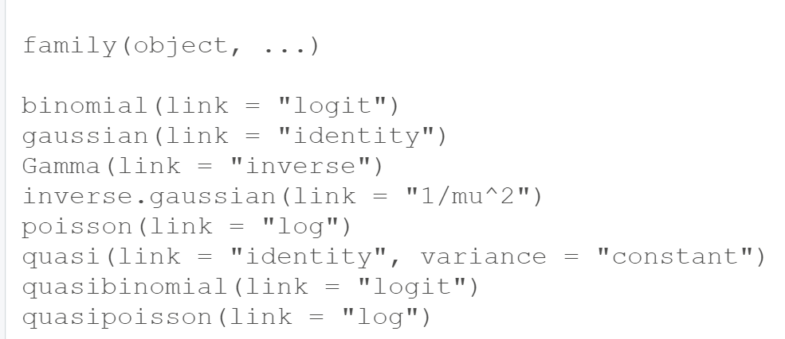
data = data =
glm(data =<dataframe>, formula= <y> ~ <x>, family = )
glm(data =<dataframe>, formula= <y> ~ <x>, family = )
glm(data =<dataframe>, formula= <y> ~ <x>, family = )
For more in GLM in R: check the hyperlink

Slide 20
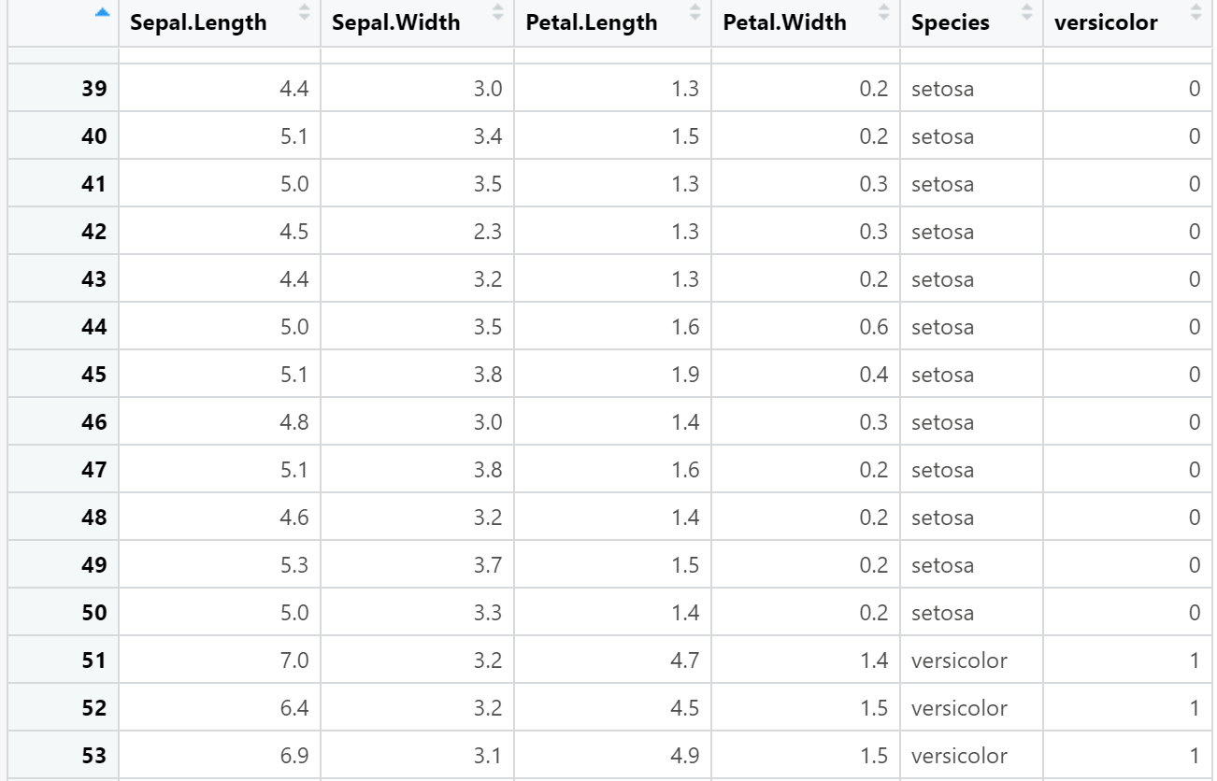






Slide 21
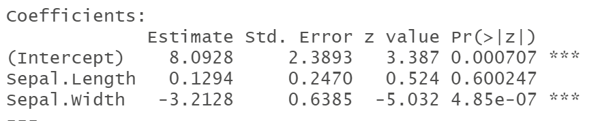


$$β_{0}+β_{1}x_{1}+β_{2}x_{2}$$
$$8.0928+0.1294×SL−3.2128 ×SW$$
$$\hat{y_{i}}≠8.0928+0.1294×SL−3.2128 ×SW$$
$$g(\hat{y_{i})}=8.0928+0.1294×SL−3.2128 ×SW$$
$$ln\frac{\hat{y_{i}}}{1−\hat{y_{i}}}=8.0928+0.1294×SL−3.2128 ×SW$$

Slide 22
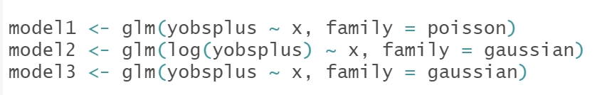
True/Flase Check Point
1) Model1 used a link function not a transformation
2) Model2 and Model3 can be also done by lm with maintaining the results

Slide 23
Statistician: Karl Pearson
“Correlation does not imply causation”

Slide 24
References
1
2
3
Stat 501
Pennsylvania State university
Stat 504
Pennsylvania State university
Statistics for Applications
Massachusetts Institute of Technology

Slide 25
Thanks!
Do you have any questions?
AmmarHawashem@gmail.com
+966 57 639 6448
LinkedIn

